Slide 1
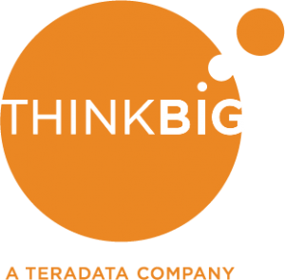

SKYNET Analytics Roadmap

Slide 2


Think Big will lay the foundation for data driven decisions and superior return of investment
by providing SKYNET with unique competitive advantage through analytics

Slide 3

Commercial Aircraft Fleet ~8,000
FAA estimates 80% need ADS-B transponders
Use Case Scoring
10% Market
Share
$64
Million
Phil

Slide 4

Sales Revenue
100%
80%
$640M
60%
$512M
40%
$384M
20%
$256M
Market Share (%)
$128M
Revenue
Notes:
Beware, the vast number of planes in the US are not used commercially. It is not clear if they are a target market as well. E.g. there are about 40k Cessna 172 worldwide. Let’s offer Phil that we can identify the most important commercially used airplanes and then also the most important private ones as well, should he wish to go down the B2C route.

Slide 5

There are 3,138 FBOs
Use Case Scoring
Reduce operating costs ~$10k per month
Charge subscription at $1k per month
10% Market
Share
$3.8
Million p.a.
Cliff
Notes:
Point here: recurring revenue. Subscription model

Slide 6
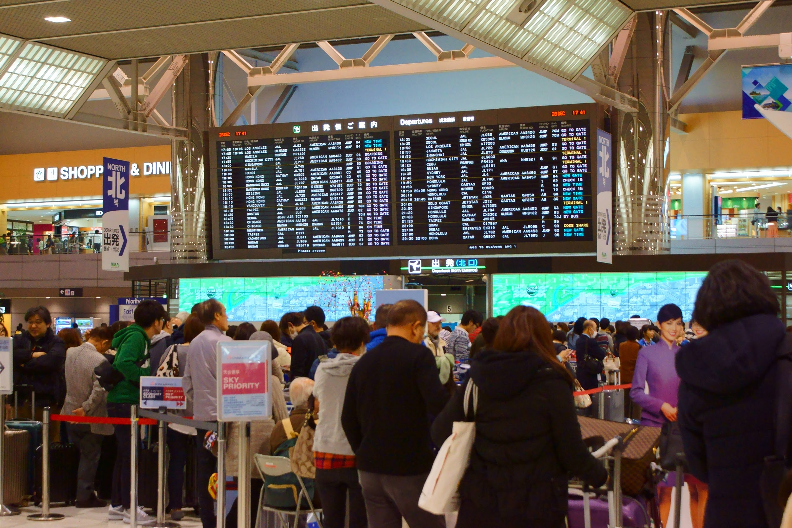
In 2015 more than 890 million passengers traveled by air.
Many were delayed, not being informed.
1% of Passengers
$110
Million p.a.
Cliff

Slide 7

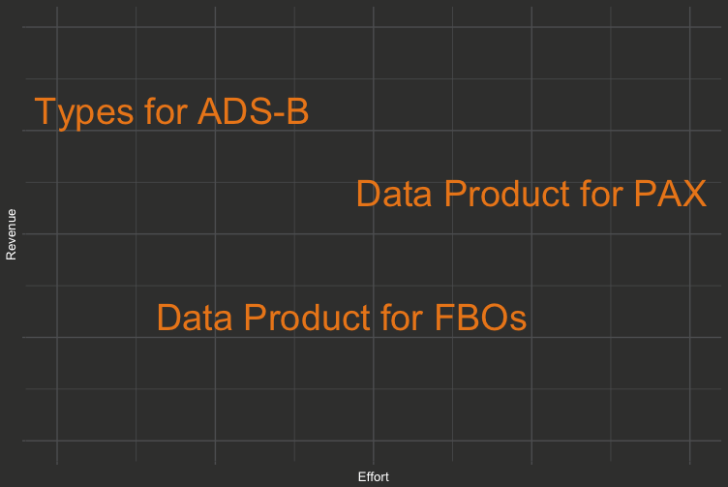
Use Case Scoring

Slide 8
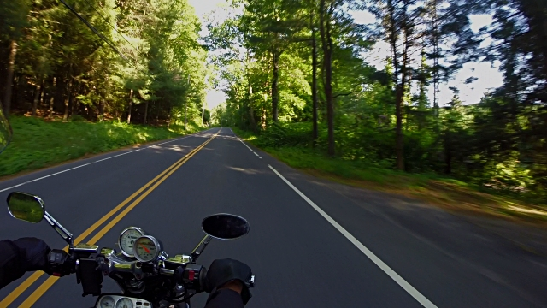
SKYNET Continued Revenue Roadmap
UC1:
Gain insights on market
Productionize infrastructure from UC1 and develop further products for FBOs, PAX
Q1 Q2 Q3 Future
Use case 1:
Aircraft Type Identification
Use case 4:
Transponder failure prediction
Use case 2:
Services to FBOs
Further products from the Data Foundation
Use case 3:
Services to PAX
Notes:
We want Skynet to take the decisions that are right and will ensure the continued growth of the company
UC1 is approx 4 weeks
Even it it is infeasible to do the certification business, Think Big will have laid the data foundation for further business

Slide 9

Ensuring continued success for SKYNET
greenteam@thinkbiganalytics.com

Slide 10
Backup Slides

Slide 11

Building on Top of the Foundation
Aim: Predict flight behavior & aircraft arrival times
Generated value: Versatile analytical model
Integrated Analytical Data Set
...
Real Time Weather Data
Arrival Time Model
NOTAM Integration
Real Time Transponder Data
Notes:
After conducting the feasibility study, Skynet will be able to make informed decisions about which route to take to ensure maximum growth of revenue

Slide 12
UC 1: Identify top aircraft models
Aim: Identify top models to certify
Generated value: targeted list of models
Effort: 1 week engagement
Integrated Analytical Data Set
Top Aircraft models
Most profitable
Predicted revenue

Slide 13
UC 2: Data Product for FOBs
Aim: Deliver high-impact predictive product for FOBs
Generated value: Product directly sellable to FOBs
Effort: eight weeks, subscription + operations
Arrival Time Model
Enabling FOBs
Schedule shifts
Cut costs
Optimize revenue

Slide 14

Feasibility Study: Determining Optimal Spend
Aim: Generate insights to decide on business case
Generated value: Integrated data set
ADS-B Data (Sheldon)
Predict entire US for in 6 Months
Integrated Analytical Data Set
Modelling develop-ment over time
DoT Flight Delay Data
FAA Flight Registry Database
Modelling Boston Area

Slide 15
UC 3: Data Product for PAX
Aim: Deliver easy to use product for PAX
Generated value: App sellable directly to end users
Effort: five weeks + subscription + operations
Arrival Time Model
Empowering PAX
Optimize itineraries
Additional monetization with ads

Slide 16
UC 4: Blasting the Competition out of the Water
Aim: Discover when other transponders will fail
Generated value: Competitive advantage
Effort: four week engagement
Integrated Analytical Data Set
Analyze time to failure
Arguments for Skynet
Discover & circumnavigate pitfalls

Slide 17
Sound Decisions
Feasibility study for certifying transponders to the biggest airlines
Notes:
We have heard some different opinions being voiced within the company. What we see as most important is to lay the foundation for sound decisions
This is the key selling point for us. By landing the feasibility study, we will be laying the foundation for further data analysis with Skynet

Slide 18
Alternative Revenue Streams
Supporting FBOs with
predicting flight delays
Distribution of maintenance sites
Failing transponders of the competition
Optimization of FBO services (when to stock on fuel, etc.)
Notes:
With the ThinkBig data foundation laid in place, multiple opportunities open up for Skynet.
Skynet will be able to continuously asses the best revenue streams and use the same data foundation to create and maintain services for e.g. FBOs or airline passengers

Slide 19
Think Big will be able to deliver the infrastructure, analytics and continued improvement of Skynet's data foundation
Notes:
… for continued growth [happiness, world peace etc.]… (the sentence in the slide will be too long, so let's just convey the message)

Slide 20
Think Big will enable Skynet to continuously make the best and most informed decisions in years to come

Slide 21
Which way to increased revenue?

Slide 22
Reference Business Architecture for the Sentient Enterprise
A sustainable, evolving environment for Intelligent and innovative decision making
Questions
Contexts
Relationships, Temporality
WHY DID IT HAPPEN
Curate, Access, BIO’s
Enables
Localities
Sentience
relate
Facts
Insights
ingest
Arenas of
Action
deliver
Data Sources
Acquisition, Curated, Access.
Known KPI, Events
WHAT HAS HAPPENED
What Could / Will Happen
Awareness enabled by Analytics
Delivery, R&D
Becomes
Value
Notes:
When the business stops asking questions or loses interest, the ecosystem shrivels and dies.
Business View
In the BIAS Architecture we start with the Business View of the problem.
The Path to Value in a Big Data World indicates the business level of involvement that should determine requirements and priority for the analytics.
Contexts
Questions enter and provide a context to the analytics needed for the business user.
Execution context must include frequency; will the question be regular or ad hoc.
The data needs identified (scope of the data in sources and history), timing (current, point in time etc) and the context of WHY this question is being asked and what kind of outcome is expected (Benefits or Value).
The context states the business algorithm anticipated (although this may be vague or high level in many cases) this is a WHAT is to be done rather than a HOW it is to be done.
Priority and relevance of the question is to be determined.
This process is iterative.
The Context is used to RELATE the data and processing.
Facts
Facts are data or information that expresses some known event. The data indicates something that has happened, it may be low lever events (eg a single transactional output, single web interactions, delivery of an article to a consumer, etc) or higher level KPIs that have been built from other data (eg profitability, total sales, failure rates, segment, score, etc) and Facts my be classic structured data or image, video, semi-structured.
Facts may have a series (historical) or be as single point in time.
All facts are what HAS HAPPENED. It is important to note that “forecasts” are Facts and they too HAVE HAPPENED, that is they have been defined and instantiated (observed).
Facts exist, they may or may not exist together that is not relevant to the Question being asked only to the localities of use and a relative priority of the question.
Localities
Localities designate the RELATING of data and business question to DELIVER an INSIGHT. The place of execution for the question.
Localities have arenas of processing. The ARENAs of action will be workload and priority related uses of the locality.
The Question context (business algorithm) and the scope of the Facts determines the specific localities requirements.
These in turn can be mapped to a physical locality.
Many arenas may exist in the same Locality based on the workload priority.
As the Question context evolves the Arena of processing may change in the locality or the Locality may change, ergo the context of the question informs the Workload requirement needed by the Arena.
This is logical, not physical at this point. There may be many physical options for locality.
Insights
Insights are the result of the execution of a business context in a locality. It is a meaningful answer to the business question. Insights may be fleeting, permanent and historical; these are the Custom Data Sets that answer the question being asked.
The INSIGHT may be final solutions and may move into the domain of Facts to assist in solving other questions.
The Insight may feedback to the Question Context and alter that and may thus over time alter the scope of facts needed and the locality of the execution (eg prototype to production report).
Insight thus have a life and follow on re-usage.

Slide 23
Business Contexts
It is never what IT wants or can do, it is what the Business Need to do
Business Questions
Are WHY we need an analytics ecosystem
Some are repetitive, some ad hoc, some regulatory, some simple, some complex, some require an answer now, some are in response to an emergency, some in response to opportunity
All tend to raise more questions
All provide feedback to increase the understanding of the business
Automated feedback is highly desirable; increasing prescience
Business Localities
How the Questions are Answered
A locality is
The right information, processed with the right application on the right system
Everything in it’s place
A set of Facts (Data) to investigate, select and integrate
An algorithm executing over the Facts to determine the Insights
Scoring, Event Detection, KPI generation, ad-hoc
An execution Platform on which the algorithm runs

Slide 24
SKYNET Business Architecture
A sustainable, evolving environment for Intelligent and innovative decision making
What aircraft models do I certify to maximize sales revenue?
How can I predict aircraft arrivals at FDO sites to optimise services delivered?
How can I predict flight delays?
Can I observe faults/quality issues in my competitions equipment?
Questions
Contexts
Relationships, Temporality
WHY DID IT HAPPEN
Curate, Access, BIO’s
Enables
Localities
Sentience
relate
Certification of highest sales volume Aircraft
Aircraft Arrival Timetable for FDO Service planning
Flight Delay predictions for FDO
Identification of competitor replacement marketing opportunities
Facts
Insights
ingest
Arenas of
Action
deliver
Weather
Aircraft
Broadcasts
FlightAware
What Could / Will Happen
Awareness enabled by Analytics
Delivery, R&D
Acquisition, Curated, Access.
Known KPI, Events
WHAT HAS HAPPENED
Airframe
Registration
Becomes
Value
Data Sources
Notes:
When the business stops asking questions or loses interest, the ecosystem shrivels and dies.
Business View
In the BIAS Architecture we start with the Business View of the problem.
The Path to Value in a Big Data World indicates the business level of involvement that should determine requirements and priority for the analytics.
Contexts
Questions enter and provide a context to the analytics needed for the business user.
Execution context must include frequency; will the question be regular or ad hoc.
The data needs identified (scope of the data in sources and history), timing (current, point in time etc) and the context of WHY this question is being asked and what kind of outcome is expected (Benefits or Value).
The context states the business algorithm anticipated (although this may be vague or high level in many cases) this is a WHAT is to be done rather than a HOW it is to be done.
Priority and relevance of the question is to be determined.
This process is iterative.
The Context is used to RELATE the data and processing.
Facts
Facts are data or information that expresses some known event. The data indicates something that has happened, it may be low lever events (eg a single transactional output, single web interactions, delivery of an article to a consumer, etc) or higher level KPIs that have been built from other data (eg profitability, total sales, failure rates, segment, score, etc) and Facts my be classic structured data or image, video, semi-structured.
Facts may have a series (historical) or be as single point in time.
All facts are what HAS HAPPENED. It is important to note that “forecasts” are Facts and they too HAVE HAPPENED, that is they have been defined and instantiated (observed).
Facts exist, they may or may not exist together that is not relevant to the Question being asked only to the localities of use and a relative priority of the question.
Localities
Localities designate the RELATING of data and business question to DELIVER an INSIGHT. The place of execution for the question.
Localities have arenas of processing. The ARENAs of action will be workload and priority related uses of the locality.
The Question context (business algorithm) and the scope of the Facts determines the specific localities requirements.
These in turn can be mapped to a physical locality.
Many arenas may exist in the same Locality based on the workload priority.
As the Question context evolves the Arena of processing may change in the locality or the Locality may change, ergo the context of the question informs the Workload requirement needed by the Arena.
This is logical, not physical at this point. There may be many physical options for locality.
Insights
Insights are the result of the execution of a business context in a locality. It is a meaningful answer to the business question. Insights may be fleeting, permanent and historical; these are the Custom Data Sets that answer the question being asked.
The INSIGHT may be final solutions and may move into the domain of Facts to assist in solving other questions.
The Insight may feedback to the Question Context and alter that and may thus over time alter the scope of facts needed and the locality of the execution (eg prototype to production report).
Insight thus have a life and follow on re-usage.

Slide 25
SKYNET Information Architecture
Success starts with an understanding of how to orderly arrange data for analytics
Sources
Any system or process that provides data that can or may be used for analysis. These sources can take the form of highly structured, such as a database or in multi or unstructured format such as log data or machine generated data.
Acquisition ^{1..n}
Acquire data from one or more sources and do very minimal work to make some of it consumable.
Curated
Perform transformations on some of the data to aid in generalization, reuse and promote cross-functional usage through common relationships.
Access ^{1..n}
Optimize data for access in cases where it is frequently used to make access easier and faster.
Delivery
The usage of data for various types of analysis: Descriptive, Diagnostic, Predictive, or Prescriptive.
Relevant terms:
Generalized Core; Extensible layer;
Data Product; Foundation;
Facts; Relationships
Relevant terms:
Ingest; Landing; Staging; Buffer;
Data Lake; Facts; Events
Relevant terms:
Business Specific; Semantic Layer; Data Mart; Facts; KPIs
Research and Development ^{1..n}
A ‘sand box’ area to support rapid evaluation of data with less formality of data governance rules which are applied to the other tiers.
Relevant terms: Discovery; Data Labs; Sandboxes/Sandpits; Agile; Insights;
Notes:
There are no arrows on this diagram as we are discussing information abstraction, not how data flows across the ecosystem.
Why is CEP not included? The advocated position is that CEP is an application, therefore sits in the application architecture. CEP acquires data from source and applies a decision framework to it, generating decisions/actions which are then recorded into a combination of Acquisition, Curated and Access information stores.

Slide 26
SKYNET Application Architecture
VIRTUAL QUERY
Success continues with providing application functionality to transform data into information
Sources
Complex Event Processing
Delivery
Real Time Decisioning
Data Fabric
Right Time
Alerting
Data Ingestion
Data Containers
Source Key Data Models
Curated Data Models
Access Data Models
Analytic
Models
INGEST
Dashboards
Key Service
Curation Processes
Metadata and Lineage
Security
Edge Analytic Processes
Light Integration
Self Service Analytics
Research and Development ^{1..n}
Reporting
Hypothesis Testing
Model Design
Data Labs
Asset
Verification
Agile
Discovery
Notes:
TODO: Add definitions for different colors
Finish off agile discovery
Mention Data product in definitions
Complex Event Processing (CEP) utilises decision frameworks which are built from curated and historical (acquisition) data. Specific physical data containers may be built in the access layer to provide low latency lookups or pre-formatted data specific to the CEP engine. Results and decisions made by the CEP engine are ingested into the Acquisition data containers to create a permenant record of actions and decisions made.
Real Time Decisioning processes observe, monitor and interact with real time streaming of data into the ecosystem, using decision frameworks generated from models and updated in real time to incorporate the decisions made. The decision frameworks are the output of various models executed within the data fabric, using curated data models for single view and training/learning from history stored in source key models. Decisions made are captured and ingested into the data fabric, to be used as a record of actions taken and input into the evolution/refinement of future models, completing the feedback cycle.
The Data Fabric represents the entire set of data within the analytics ecosystem, the universe of facts that is stored, processed, curated and created. It is a fabric because individual data containers may be physically located on one of a variety of platforms within the ecosystem, yet the data must be accessible and useable from anywhere within the data fabric, using appropriate data virtualisation systems to access the data in place, and transport the answer sets across the fabric to the point of answer.
Data Ingestion services acquire data from sources and send it to the data fabric, to one or many destinations. It may be streaming or batch mode, depending on the data source, however it is expected that streaming ingestion will become the standard practice as it offers increased flexibility and can incorporate data enrichment/enhancement at the point of ingestion into the data fabric, enabling conformed keys to be spread throughout.
Light Integration represents the initial, and minimal, assignation of surrogate keys at the point of entry of data into the ecosystem. This enables conformed keys to be spread throughout the data fabric, and also enables resolution of privacy and security requirements of sensitive data.
Data Containers are a variety of data storage applications, using the best fit for purpose applications available. Examples of these include, but are not restricted to, relational database, key/value pair, document store and HDFS. A variety of data storage applications is required to efficiently store and process the wide variety of data within the ecosystem.
Key Service provides key resolution services for the entire data fabric, to ensure consistency and conformance of keys within the ecosystem. This is a key enabling service for the data fabric as it makes usage of data across the fabric - located in different data containers easier, increasing efficiency and performance. The key service embodies the principle of reuse, enabling key resolution to be performed once in the ecosystem and reused every time that data is accessed.
Source Key Models contain the record of data received from source systems, with the addition of keys resolved by the light integration processing, and processing lineage columns to record when that fact was ingested into the ecosystem. All source system data is stored in it’s natural format.
Curated Data Models contain data which has been refined and processed to incorporate varying degrees of quality, standardisation, typing, domain, integration and relations. The degree to which the curation is performed will be model specific, for example a core party table in an Integrated Data Warehouse model would be very highly curated, whereas a collection of survey results would have some curation applied to the important relationship columns, but leaving the rest of the data relatively untouched, with perhaps some quality filtering applied.
Access Data Models store data in specific formats required to answer well defined sets of questions, to provide optimal performance for delivery of that data to consumers.
Model Scoring is the process of executing defined, productionised predictive models to generate the set of observations, classifications and actions required to drive behavioural analytic platforms such as marketing and customer relationship management
Curation Processes are applied to data containers to curate data and apply business rules, data quality, data typing, data manipulation and preparation and derivation of values. This represents the bulk of the traditional “ETL” processing.
Metadata and Lineage is vital to the data fabric to ensure that data is consumed with a well known heritage and quality. The provenance of data used to create an answer is critical to understanding the reliability of that answer and it’s value as input into making business decisions. The metadata also provides a library and record of your data assets within the ecosystem, allowing users to explore and discover data available within the fabric and gain an understanding of the data itself, through data profiles, samples and definitions.
Security is critical within the data fabric and embraces the broader security requirements of the ecosystem. Sensitive data must be masked or encrypted, Data must be protected from unauthorised access, data storage and use (eg: personally identifiable information) must be aligned with regulatory requirements and the ecosystem itself must be protected from external access and/or attack. Security requirements are further extended with the extension of the data fabric into the cloud, which can be in external data centers and offshore locations.
Analytic Processes perform analytics on data on a scheduled or on-demand basis, implementing production analytic processing required to operationalise delivery of insights to the organisation. After the analytic discovery process is complete, and an insight has been discovered, the true value is realised when that process is operationalised and becomes repeatable, incorporating those insights into the information used to make business decisions, delivered to users or provided to automated decisioning platforms such as CEP.
Hypothesis Testing is the data science process for discovering new insights. Using a wide variety of analytic techniques to test ideas in an iterative process, requiring agility and flexibility and data variety.
Data Labs provide a self service capability for data research and development, allowing users to load custom data and prototype analytic processes for value discovery, prior to committing to, and investing in, operationalisation and productionisation of new processes.
Model Design is the development of new models to predict behaviour, detect patterns and simulate changes. A wide variety of usually highly curated data is used to train models and discover the attribution required for accurate prediction.
Dashboards present metrics to the user, ranging from status of business defined KPI’s to real time instrumentation of streaming ingestion and automated decisioning engines.
Self Service Analytics provide users with point and click access to pre-defined analytic processes, providing ease of use and access to operationalised insights.
Reporting provides the day to day information on what has happened within the enterprise, which is still required for making many business decisions .
Ad-Hoc Analytics enables users to ask flexible, scenario driven questions on highly curated data. This is used to develop new strategic ideas and discover relationships between diverse concepts. Once operationalised these new strategic analytics can improve efficiency and/or performance of the business.

Slide 27
Document Information
ORIGINATOR INFORMATION
ORIGINATORS | The Green Team | CONTRIBUTORS |  | Nathan Green, Steen Manniche, Veeral Desai, Jung-Il Ko, Christoph Waldhauser
E-MAIL Nathan.Green@teradata.com
DOCUMENT CONTROL
CHANGE HISTORY
VERSION | DATE | AUTHOR(S) | CHANGE DESCRIPTION
VA00 | Mar 2017 | Nathan Green | Original draft for Skynet Bootcamp project

